Slide 1

TOP-DOWN APPROACH
Journey to your best
CHALLENGE 0:
WHAT’S
YOUR CURRENT VERSION?
Present by Binh LE

Slide 2
Agenda
What?
How?
When?
Why?
Compare?

Slide 3

What is top-down approach?
Journey to your best
CHALLENGE 0:
WHAT’S
YOUR CURRENT VERSION?

Slide 4
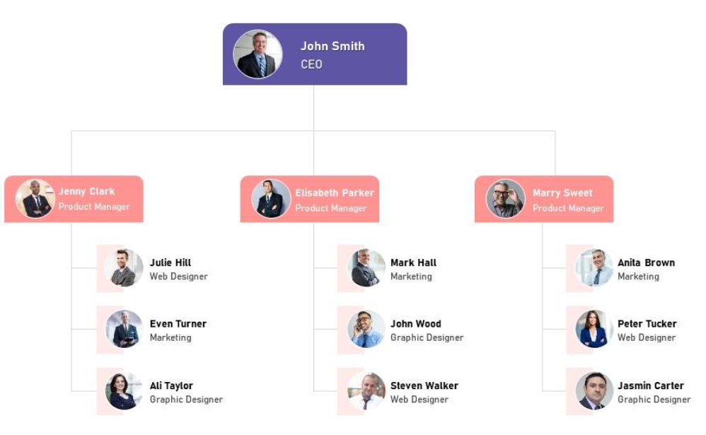
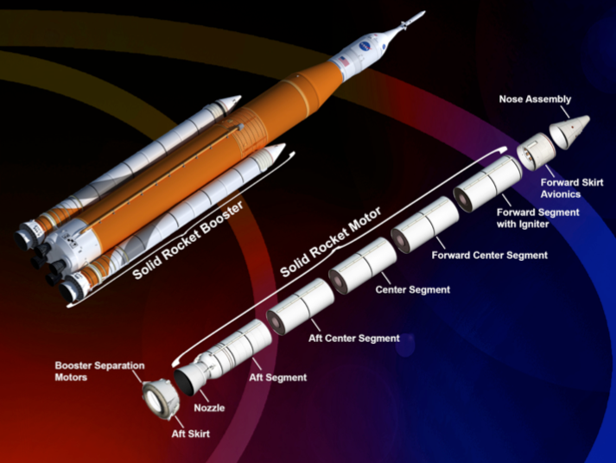
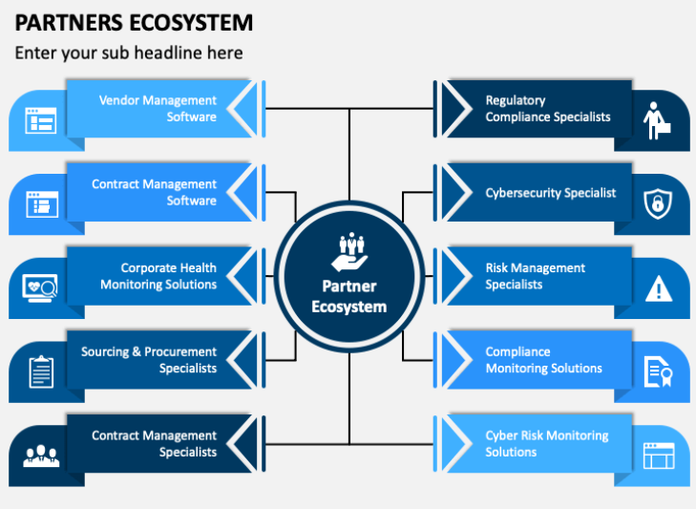

Introduction
Organization Chart
Structure of the rocket
Partner Ecosystem

Slide 5
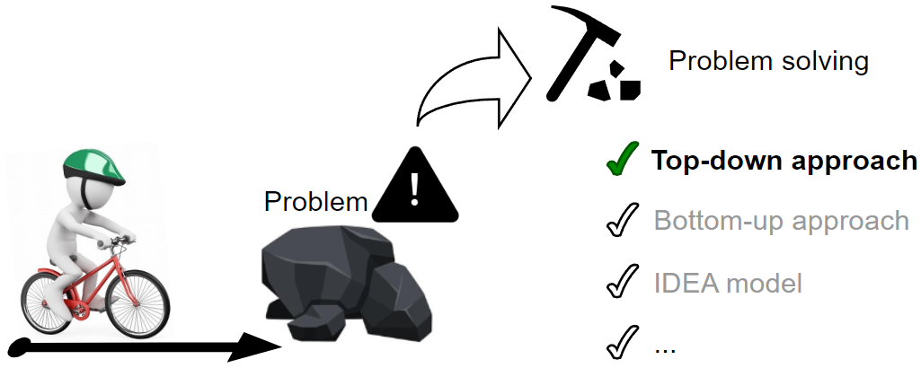
What?
Top-down approach is a hierarchical method of problem-solving that starts with an overview of the problem and divides it into smaller sub-problems.

Slide 6
How does the top-down approach do?
Journey to your best
CHALLENGE 0:
WHAT’S
YOUR CURRENT VERSION?

Slide 7
How?
Top-down Approach
Define the overall object
Establish a hierarchy
Identify key decision points
Create a comprehensive overview
Break down into smaller components
Implement, Monitor and Feedback

Slide 8
When is top-down approach utilized?
Journey to your best
CHALLENGE 0:
WHAT’S
YOUR CURRENT VERSION?

Slide 9
When?
The problem is complex and needs to be broken down into smaller, manageable parts.
Need to understand the big picture before diving into details.
Ensure consistency and quality across the organization
The solution can be divided into smaller sub-problems that can be solved independently.
The problem has multiple potential solutions, and a top-down approach can help prioritize and evaluate them.

Slide 10
Why is the top-down approach utilized?
Journey to your best
CHALLENGE 0:
WHAT’S
YOUR CURRENT VERSION?

Slide 11
Why?
Advantages
Disadvantages
Strategy Planning
Clear Hierarchy
Early Decision-Making
Easier to manage
Efficiency
Limited Adaptability
Limited to pre-determined solutions.
Less Involvement
Slow Implementation:
Resistance to Change

Slide 12
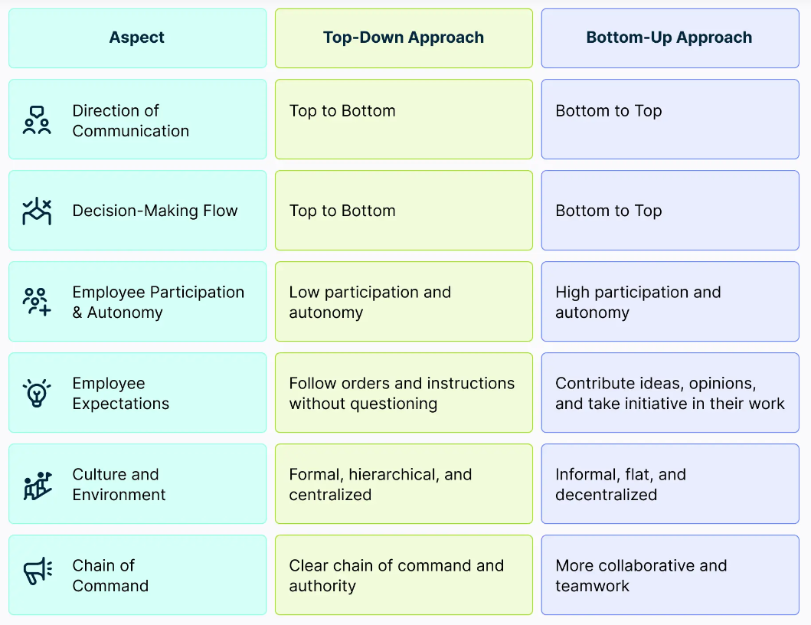

Top-down approach vs Bottom-up Approach?
Which is the best approach?
It depends on the particular context, including the nature of the problem, the resources available, the timeline, and the desired outcome.

Slide 13
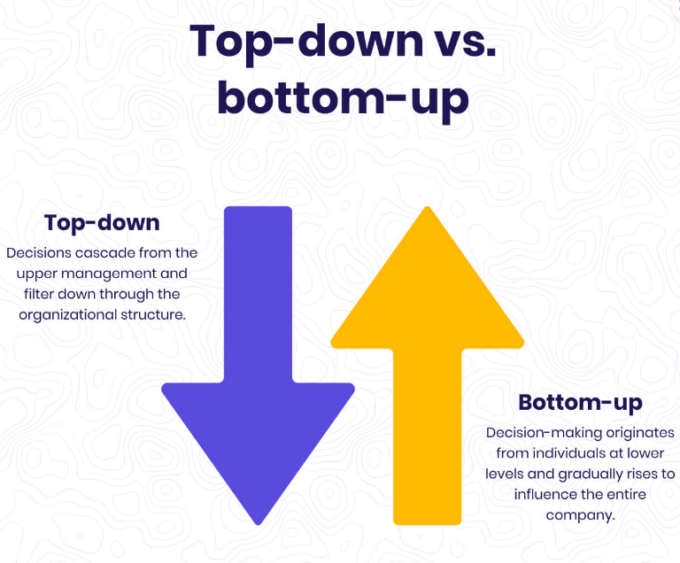
The key to success
Driving Bottom-Up Engagement In A Top-Down Organization

Slide 14
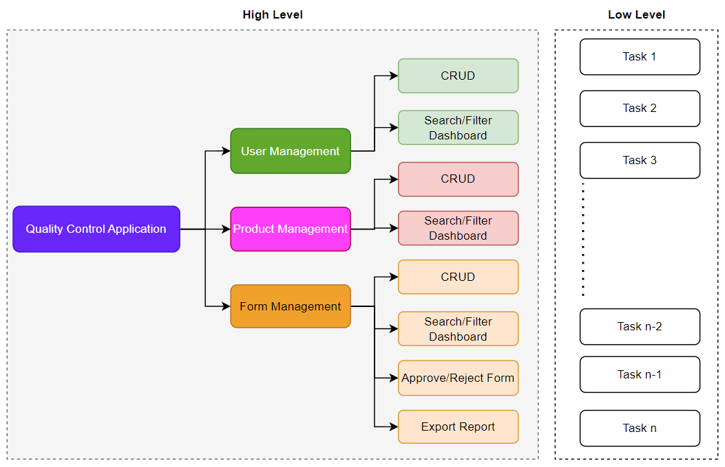
Example
Feature Diagram

Slide 15
THANK FOR YOUR ATTENTION

